Slide 1
Crossing the Chasm
IMT2019525 VIJAY JAISANKAR

Slide 2
Lime

Slide 3
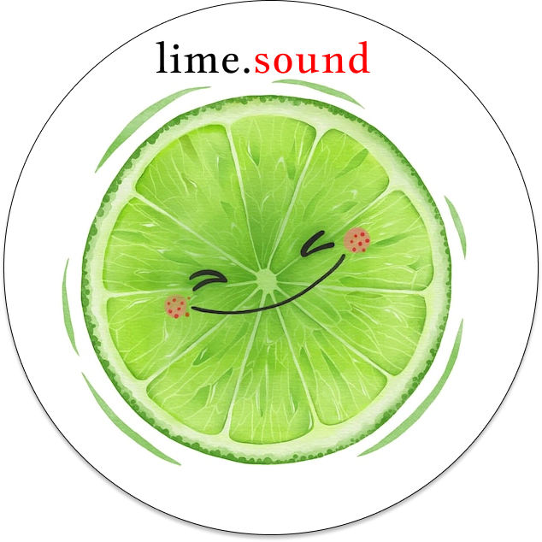
Lime: An end-to-end music creation, hosting, and promotion platform for budding creators.

Slide 4
Mission statement: Harness the power of communities and make your sounds heard.
Vision statement: To be the top preferred music platform for any new creator, anywhere.

Slide 5
Psychographic Segmentation and Targeting methods

Slide 6
Source
https://thinkinsights.net/strategy/crossing-the-chasm/

Slide 7
Innovators
Open-source enthusiasts who are interested in the scale and technical footprint of the project.
Coders and musicians experimenting with programmatically-generated music.
Beginners who are trying out new, cutting-edge tools for music production.
Technology enthusiasts

Slide 8
Innovators
Showcasing the products in summits, meet-ups and conferences, so that open-source enthusiasts can contribute to Lime.
Participating in programs like GSoD, GSoC and Hacktoberfest, that would bring buzz and value to the project.
Marketing Strategies

Slide 9
Early Adopters
Budding artists that trust Lime and its business model and the power of its community
The creators of Lime, i.e, frequent contributors and moderators who are invested
New listeners looking to discover new music and streaming platforms
Visionaries

Slide 10
Early Adopters
Keeping the Lime community active and thriving by introducing bounties for open-source contributions.
Maintaining strong social media handles that promote Lime’s values and new artists on the platform will give a nice boost to said artists and will motivate them to publish new material.
Making administrative decisions that solidify the values of Lime and documenting the same would woo new users to the proposition of the platform.
Marketing Strategies

Slide 11
Early Majority
Listeners discovering Lime after extensively using platforms like Spotify and Soundcloud
Established artists who have already published their work to other streaming platforms
Budding artists that are looking for their first record label or striving to meet their eligibility on other platforms
Up-and-coming producers who are looking for new tools that are easy to use and will help them make their first pieces of music,
Pragmatists

Slide 12
Early Majority
Lime’s unintrusive advertisements should increase user retention and keep them listening to more artists for longer
By stressing on the no-holds-barred approach of publishing music in the documentation and tutorials, budding artists can reconsider switching to Lime, and up-and-coming producers can cross the chasm of production and start producing music on Lime
Marketing Strategies

Slide 13
Late Majority and Laggards
Large artists who are already household names in the industry
Professionals and experienced producers who are proficient in other production products like Ableton and FL Studio
Skeptics

Slide 14
Late Majority and Laggards
Artists, whose songs become viral through the platform can inspire large artists to cross-release their music on Lime
Lime comes packaged with many new AI-enabled customised tools which can be used as a toolkit alongside the tools they’re currently using. Using Lime repeatedly might make it part of their repertoire.
Marketing Strategies

